Slide 1

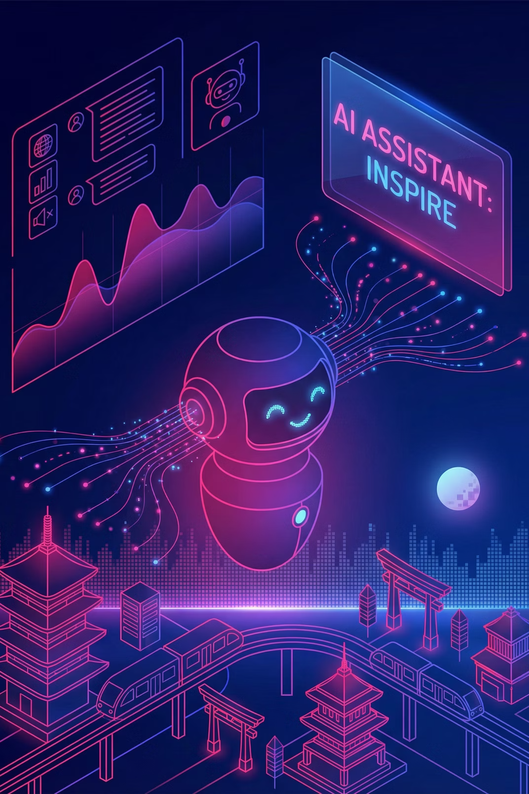
AI-Powered Chatbot for Banking
Infosys Springboard Internship Project: Revolutionizing Customer Support
BY
Aitha Rohith Kumar

Slide 2



Project Overview: Enhancing Banking Customer Support
Customer support in the banking sector is often bogged down by repetitive queries, such as balance checks, loan inquiries, card blocking, and branch information requests. Manually addressing these common questions leads to significant delays, increased operational costs, and customer frustration.
This project addresses these challenges by developing an intelligent AI-powered chatbot. Leveraging advancements in Natural Language Processing (NLP), Machine Learning, and modern web technologies, this chatbot is designed to understand natural language queries and provide accurate banking information through an interactive, 24/7 available conversational interface.
Repetitive Banking Queries
Efficiency & Cost Issues
Intelligent Chatbot Solution
Balance checks, loan details, card blocking, branch info.
Manual handling leads to delays and higher operational costs.
AI-driven, 24/7 interactive support for instant answers.

Slide 3

The Problem: Limitations of Traditional Banking Customer Service
Traditional banking customer service models are heavily reliant on human agents, which inevitably leads to slower response times and substantial operational overhead. In today's fast-paced digital world, customers expect instant, accurate, and always-available support, a demand that conventional systems struggle to meet.
The core challenge is to design and implement a system that can not only understand diverse user intents and extract critical information from their queries but also respond intelligently and appropriately. This system must also be scalable, easy to maintain, and capable of handling a high volume of interactions without compromising on quality or speed.
Dependence on Human Agents: Increases response times and operational overhead.
Customer Expectations: Demand for instant, accurate, and always-available support.
Scalability & Maintenance: Need for a system that grows with user demand and is manageable.

Slide 4
Project Objectives: Crafting an AI-Driven Banking Assistant
The primary objective of this project is to construct an advanced AI-driven banking chatbot specifically engineered to proficiently answer a wide range of common banking queries. This system aims to revolutionize customer interaction by making banking information more accessible and support more efficient.
1
Identify User Intents
Accurately classify the purpose behind each user query.
2
Extract Relevant Entities
Pull out key information like amounts, account numbers, and dates.
3
Manage Conversational Flow
Ensure smooth, logical, and contextual multi-turn interactions.
4
Provide Accurate Responses
Deliver precise and reliable information to users.
5
User-Friendly Web Interface
Offer an intuitive and accessible platform for customer interaction.
6
Admin Panel for Management
Enable efficient training data management and interaction analysis.

Slide 5
Key Features: Core Capabilities of the Banking Chatbot
This AI-driven banking chatbot is equipped with several critical features designed to deliver a seamless and intelligent customer support experience. These capabilities form the backbone of a responsive, insightful, and user-centric system.
Natural Language Understanding (NLU)
Intelligent Response Handling
Interactive Web Chat Interface
Provides contextually relevant answers with robust fallback support for unclear requests.
A modern, user-friendly platform for intuitive conversational interactions.
Advanced intent and entity recognition to comprehend complex banking queries.
Secure Admin Panel
Analytics Dashboard
A dedicated interface for secure management of training data and chatbot monitoring.
Provides insights into user behavior, popular intents, and chatbot performance metrics.

Slide 6




System Architecture: How Our Chatbot Works
The chatbot system is strategically structured into several interconnected components, each playing a vital role in processing user queries and generating intelligent responses. This modular design ensures robust performance and scalability.
Frontend Chat Interface
NLP Engine
The primary point of interaction for end-users to submit queries.
Responsible for intent classification and extracting key entities from user input.
Response Management Layer
Admin Module
Generates accurate and contextually appropriate replies to queries.
Facilitates system monitoring, training data management, and performance analytics.
User queries initiate from the interactive UI, flow through the NLP engine for interpretation, and then proceed to the response engine for reply generation. All interactions are logged and analyzed via the admin module to continually enhance chatbot intelligence and user experience.

Slide 7
Milestone 1: Establishing Intent & Entity Recognition
The foundational first milestone of this project concentrated on developing the Natural Language Understanding (NLU) engine, which is crucial for the chatbot's ability to interpret and respond to user queries effectively. This involved a systematic approach to defining banking-specific conversational elements.
We meticulously defined a comprehensive set of banking intents, encompassing common user requests such as balance inquiries, money transfers, loan inquiries, card blocking, and branch location services. To train the NLP model, a rich dataset of example phrases for each intent was created. The model was then rigorously trained to accurately classify user intents and extract vital entities, including monetary amounts, account numbers, and card types, ensuring a precise understanding of user requests.

Slide 8



Milestone 1 Outcomes: A Strong Foundation for Intelligence
The successful completion of Milestone 1 yielded significant results, laying a robust foundation for the chatbot's intelligent conversational capabilities. The NLP model achieved impressive accuracy in identifying diverse banking intents, demonstrating its ability to understand the core purpose of user queries.
92%
95%
100%
Intent Accuracy
Entity Extraction
Core Understanding
High precision in classifying user intents across banking categories.
Effective recognition and extraction of numerical and contextual values.
Ensured the chatbot comprehends user requests.
This crucial phase confirmed the chatbot's ability to accurately understand what users are asking, which is paramount for intelligent conversation handling in subsequent development stages. The precise identification of intents and entities acts as the bedrock upon which the entire conversational logic is built.

Slide 9
Milestone 2: Implementing Response & Dialogue Management
Building upon the strong foundation of intent and entity recognition, Milestone 2 focused on empowering the chatbot to manage conversations logically and effectively. This involved developing sophisticated mechanisms to ensure seamless and contextually appropriate interactions.
01
02
03
Rule-Based Responses
Contextual Conversations
Fallback Handling
Implemented pre-defined answers for common and straightforward queries, ensuring consistency.
Developed logic to maintain context across multi-turn interactions, allowing for more natural dialogues.
Integrated graceful fallback mechanisms for instances where user intent confidence is low or queries are ambiguous, guiding users to alternative support.
By establishing robust response and dialogue management, the chatbot can now engage in more meaningful and helpful conversations, ensuring a positive user experience even when faced with complex or unclear requests. This milestone was critical in transforming raw NLU capabilities into a truly conversational AI.

Slide 10
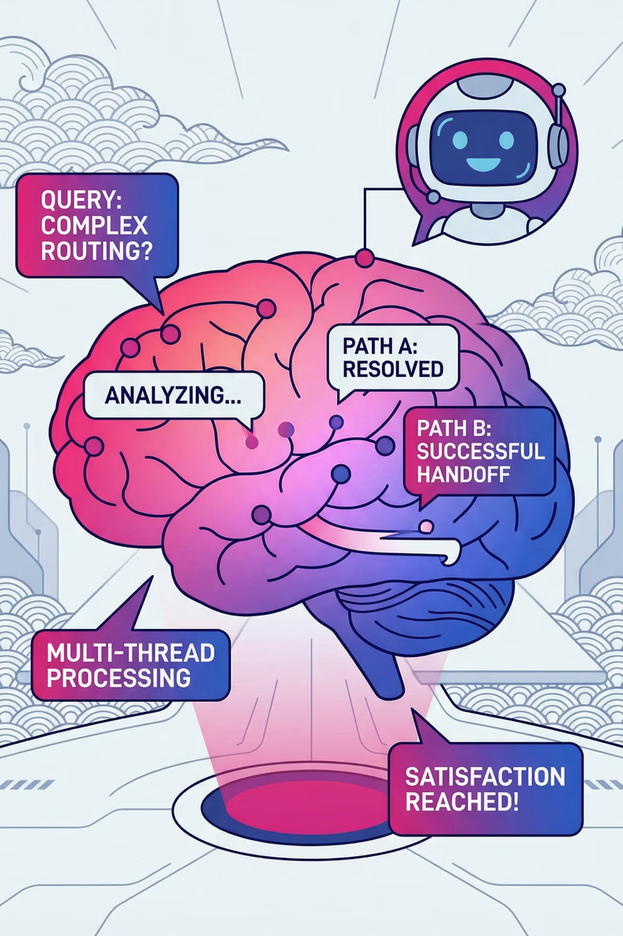
Milestone 2: Enhancing Chatbot Intelligence
Managing Follow-Up Questions
Handling Incomplete Queries
The chatbot was enhanced to understand and correctly respond to follow-up questions, creating a more natural and fluid conversation flow for users.
Robust mechanisms were implemented to interpret and process incomplete or ambiguous user inputs, ensuring the chatbot can still provide relevant information.
Context-Aware Responses
The system now maintains conversation context, allowing for accurate and coherent responses that build upon previous interactions, significantly improving user experience.

Slide 11



Outcomes of Milestone 2: Seamless Interactions
Milestone 2 was critical in evolving the chatbot from a basic query-response system to an intelligent conversational agent. The focus on context and nuance ensured a smooth and intuitive user journey.
This milestone ensured a smooth interaction flow, preventing abrupt conversation breaks and significantly enhancing the overall user experience.

Slide 12
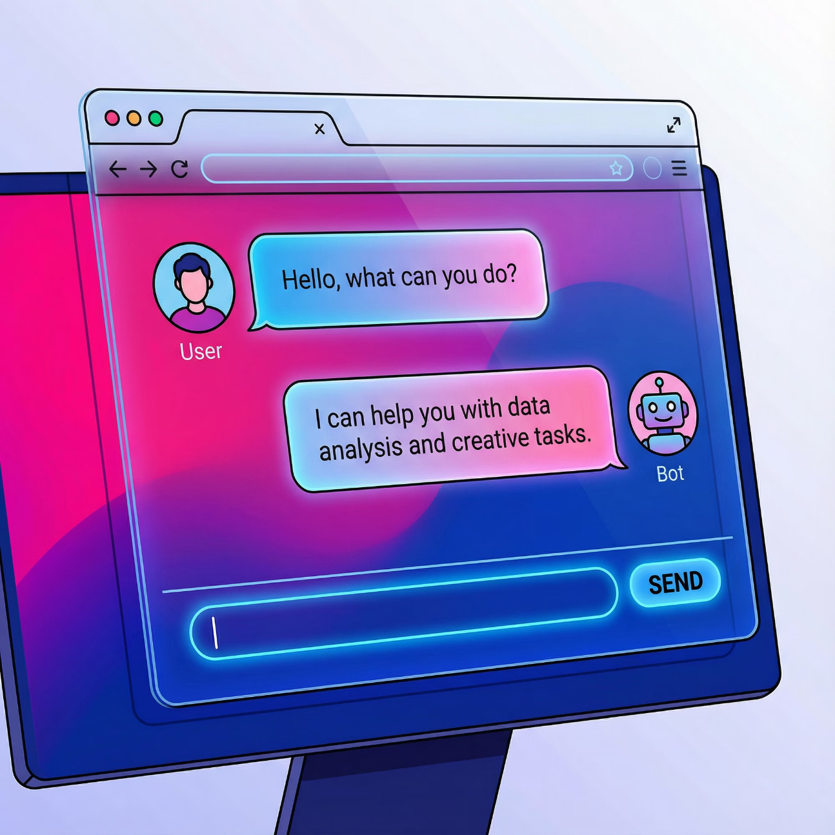
Milestone 3: User Interface Integration
Web-Based UI Development
Intuitive Message Display
A dynamic and responsive user interface was developed using Streamlit, providing an accessible platform for users to interact with the chatbot.
The UI features clear message bubbles, visually distinguishing between user inputs and chatbot responses for enhanced readability and comprehension.
Backend-Frontend Connectivity
Seamless integration of the frontend with the backend NLP and response engine ensures real-time communication and efficient data processing.

Slide 13

Outcomes of Milestone 3: Fully Functional Browser Interface
Browser
Real-Time
Stable
Access
Interaction
Application
The chatbot is fully functional via any web browser.
Users experience instant response generation, enhancing engagement.
Robust error handling ensures stability, even with unexpected inputs.

Slide 14
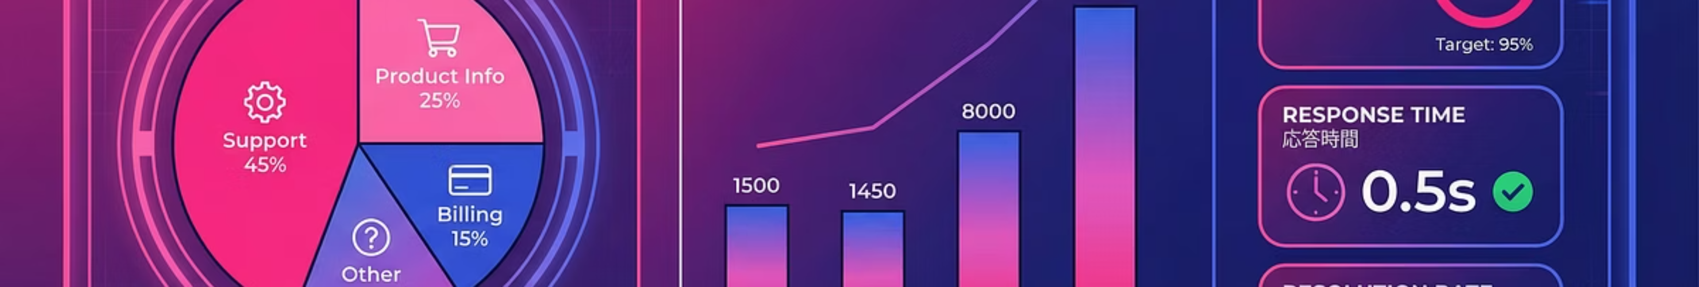




Milestone 4: Admin Panel & Analytics
Admin Panel for Management
Intent Analytics
Usage Insights
Interactive charts provide visual insights into intent distribution, helping to understand user query patterns and refine chatbot behavior.
Comprehensive analytics on user behavior and system performance are available, guiding continuous improvement and optimization efforts.
A dedicated admin panel was created for easy management of intents, training data, and chatbot responses, empowering administrators with full control.

Slide 15
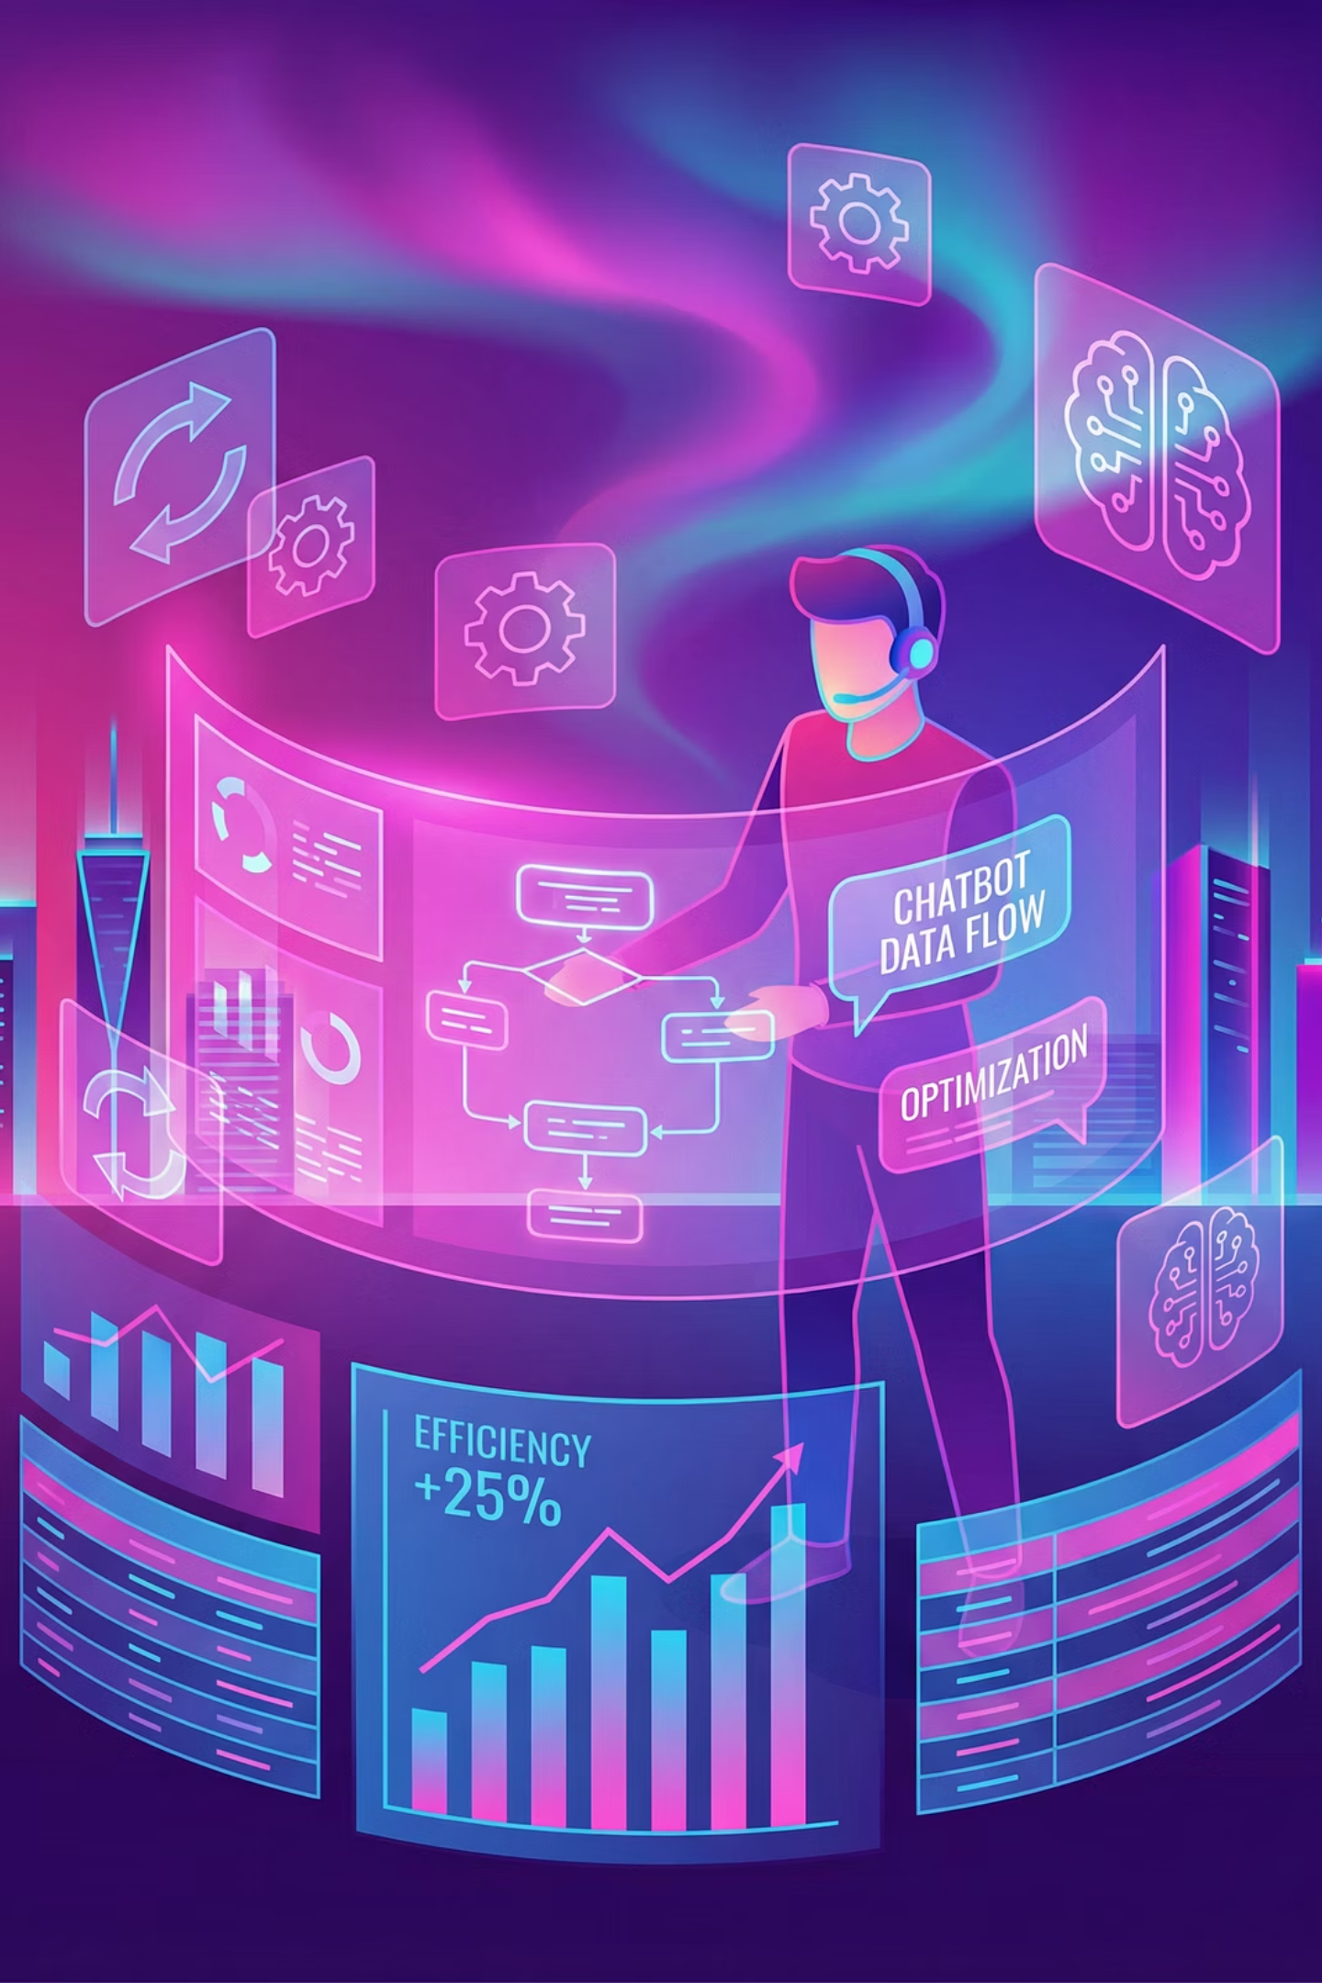
Outcomes of Milestone 4: Enhanced Scalability & Maintainability
Admins gain a clear overview of chatbot performance through intent distribution and top user queries.
Training data can be updated efficiently, enabling agile and continuous improvement of the chatbot's knowledge base.
This milestone significantly boosts the scalability and maintainability of the chatbot system, ensuring its long-term viability and effectiveness.

Slide 16
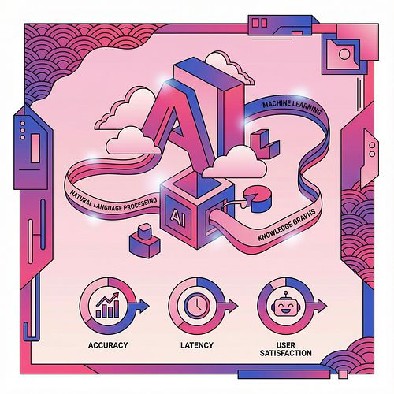
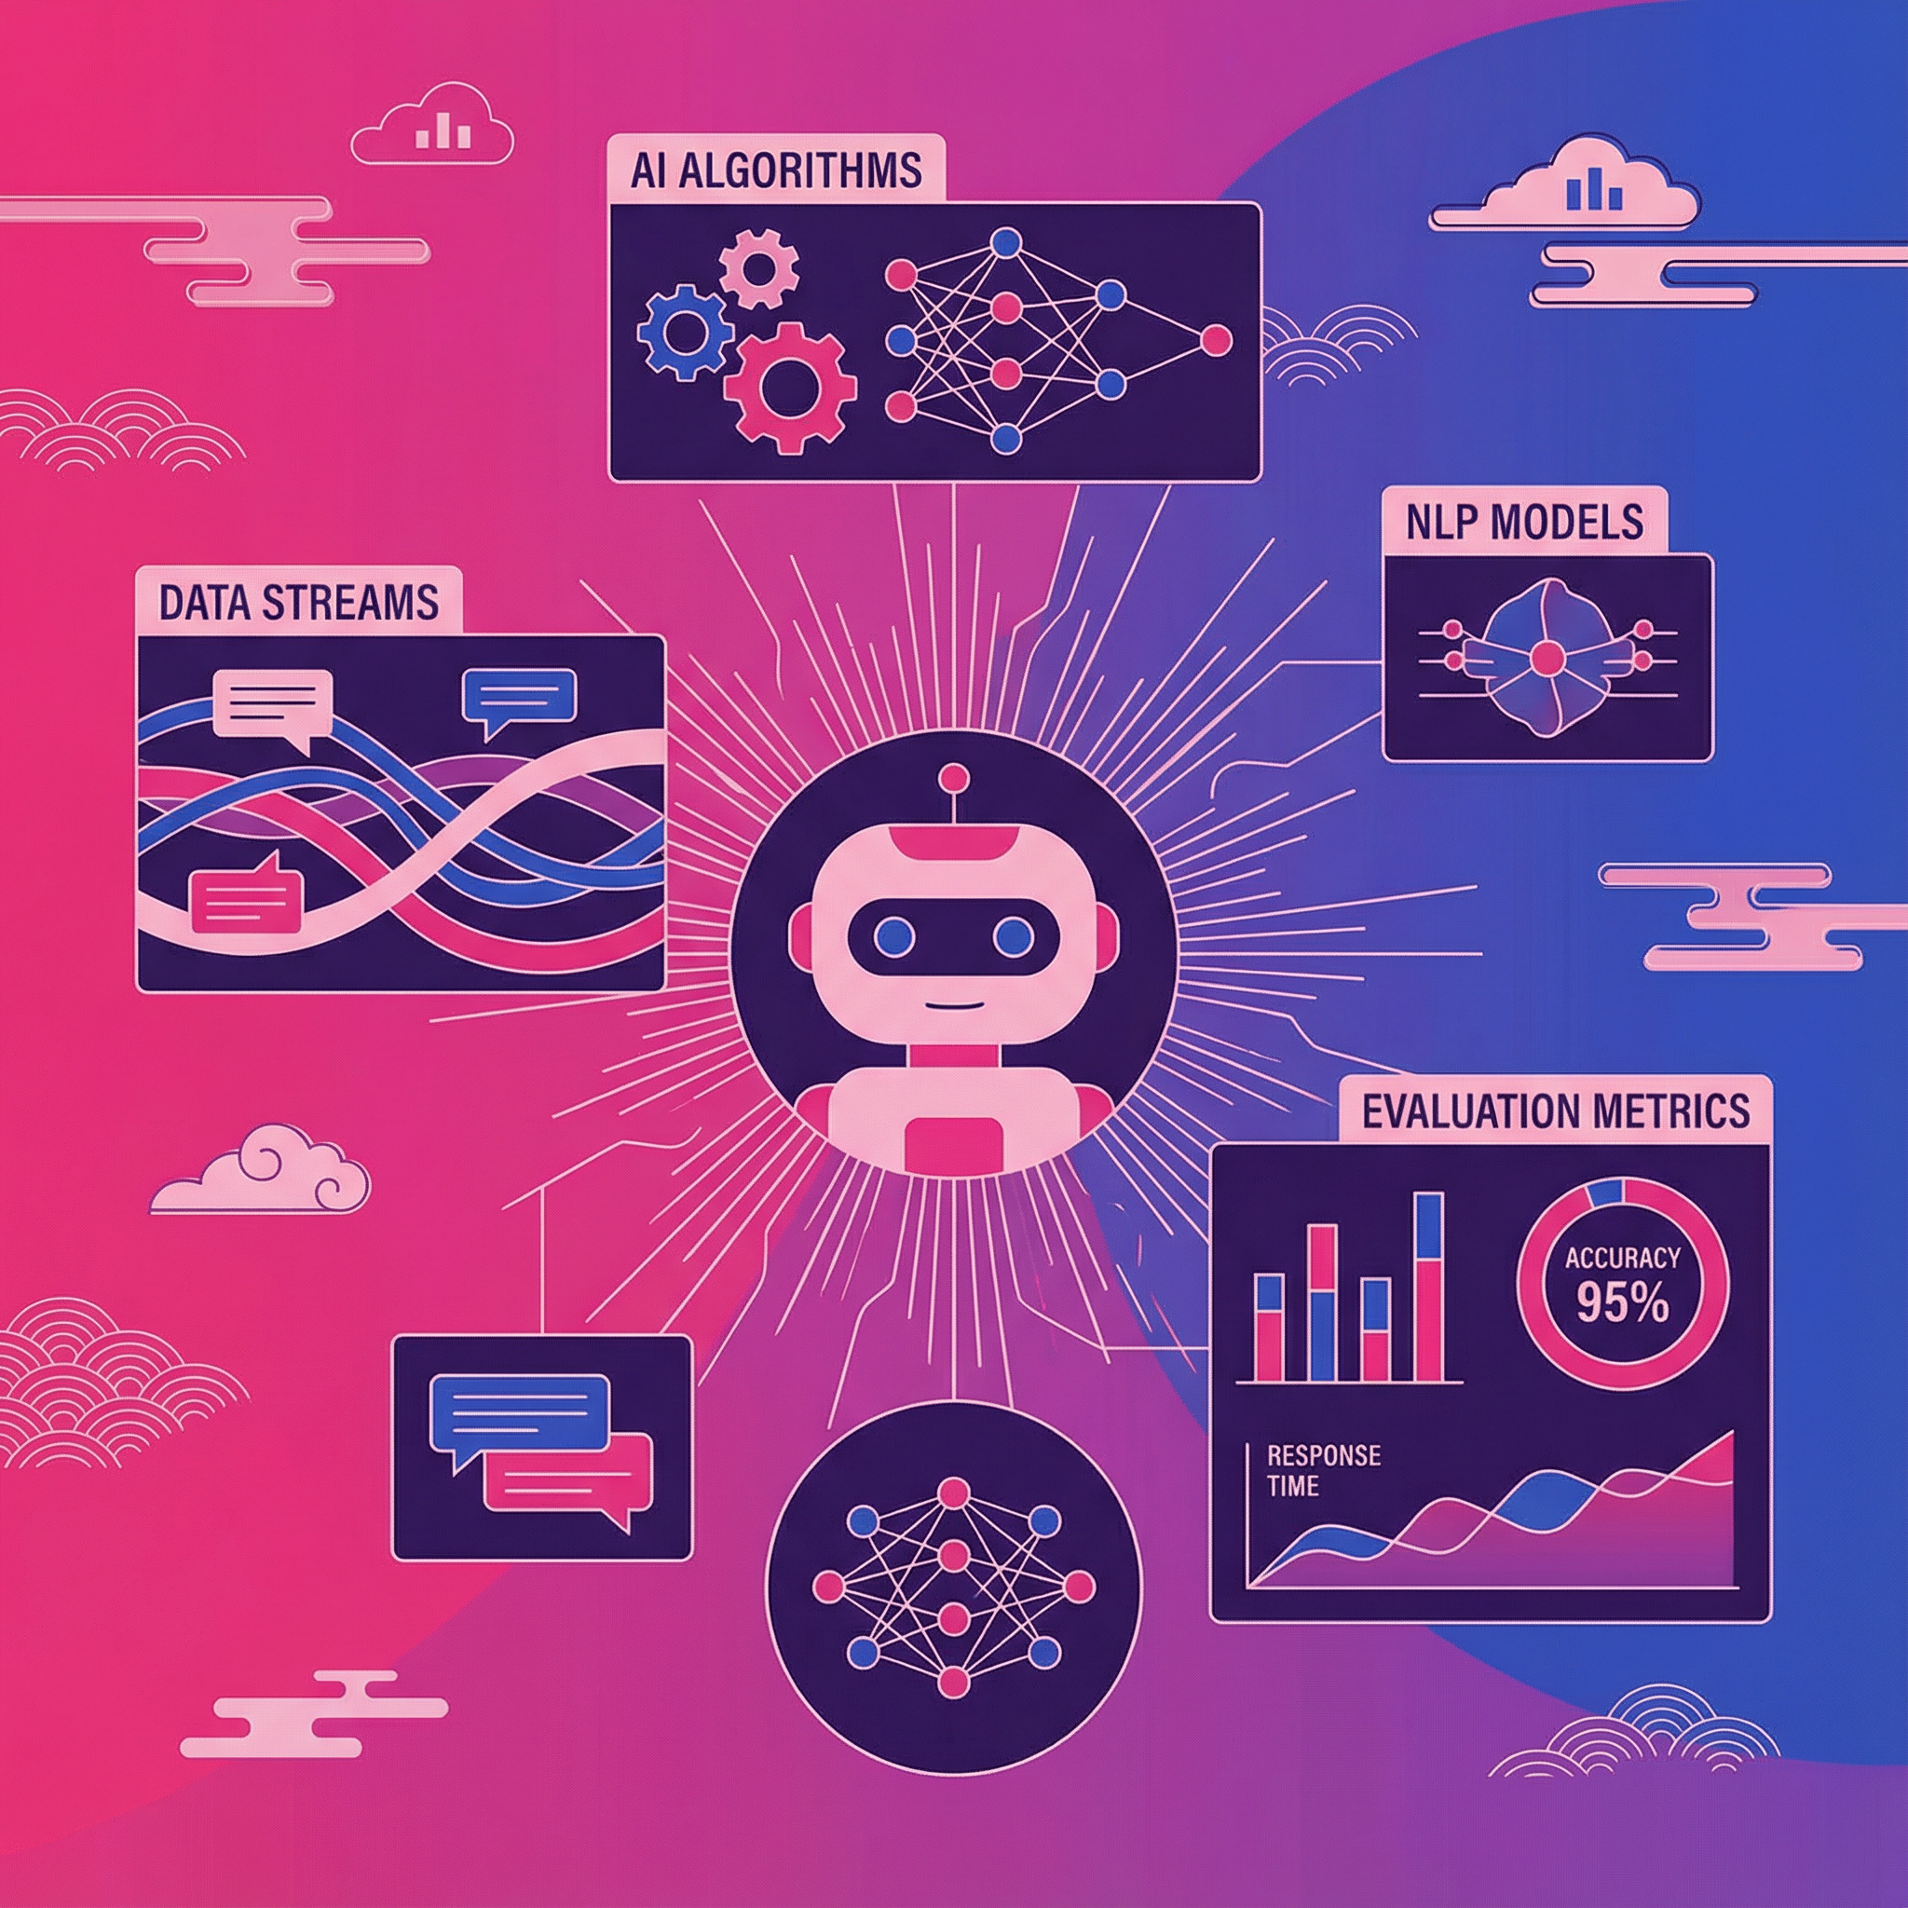
Technologies & Evaluation
Key Technologies Utilized
Evaluation & Results
All milestones were rigorously evaluated against key performance indicators:
Python for robust backend logic.
NLP & ML for precise intent classification and entity extraction.
Intent accuracy
Response correctness
Streamlit for a rapid and user-friendly web UI development.
UI usability
System stability
spaCy / ML models for advanced language processing capabilities.
The chatbot demonstrated strong performance across defined banking scenarios, proving its real-world applicability.
CSV / JSON for efficient data storage and logging.

Slide 17

Conclusion & Future Enhancements
Project Success
The AI-powered chatbot efficiently handles bank-related queries, leveraging NLP and ML to reduce manual support dependency and improve user satisfaction.
Future Vision
We envision expanded capabilities, including voice interaction, multilingual support, and integration with real banking APIs for a truly comprehensive solution.

